Slide 1
QuantumnComputing

Slide 2
Futuristic Technology

Slide 3
Pdf,Docx,Ppt,etc.,
Desktop
Keyboard
Voice Recognition
Touch Pad
Sensors
Artifical Inteligence
Book
Paper
Updating Generation
Pen
Keypad
Touch Pad
Sensors
Voice Recognition

Slide 4
Getting new Technology
START

Slide 5
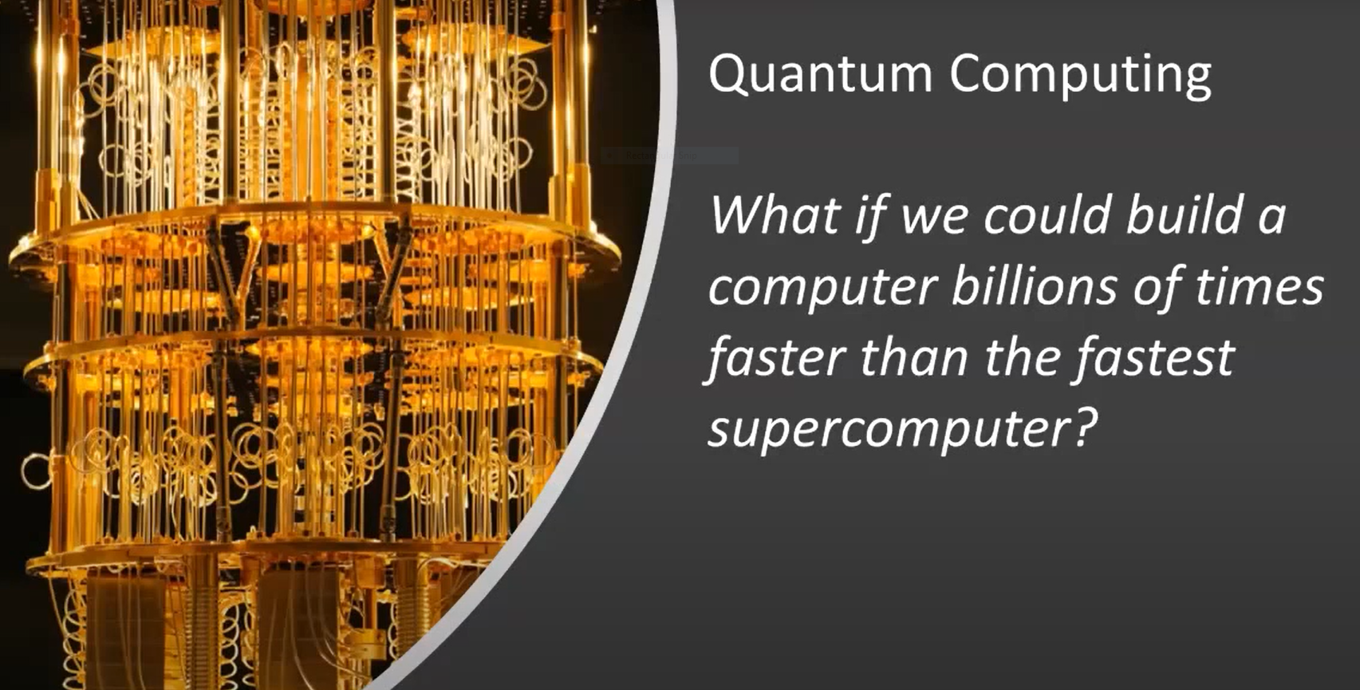

Slide 6
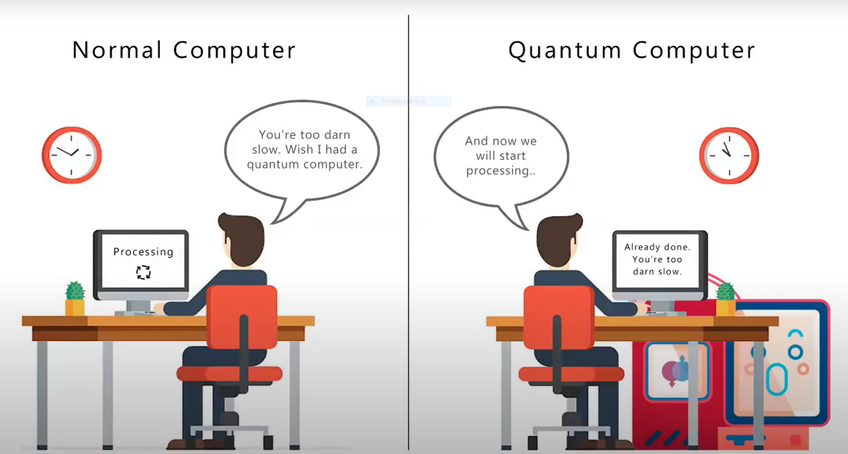

Slide 7
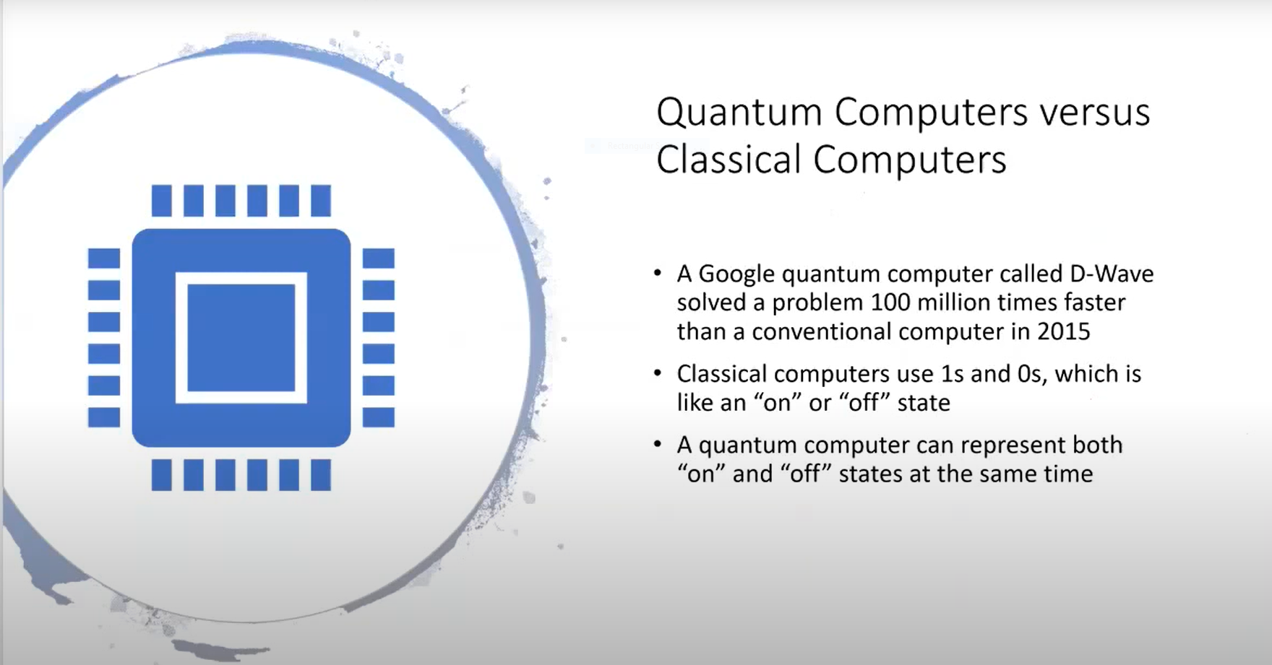

Slide 8
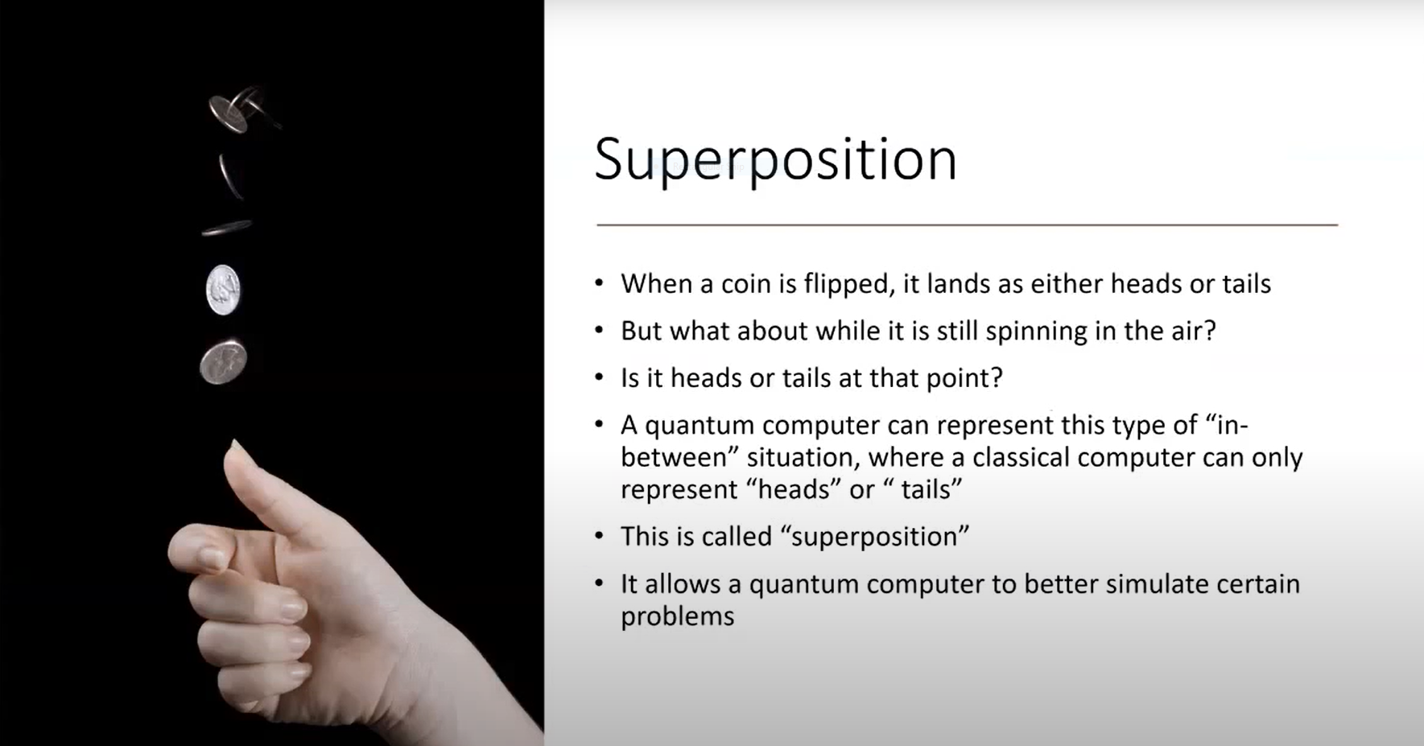

Slide 9
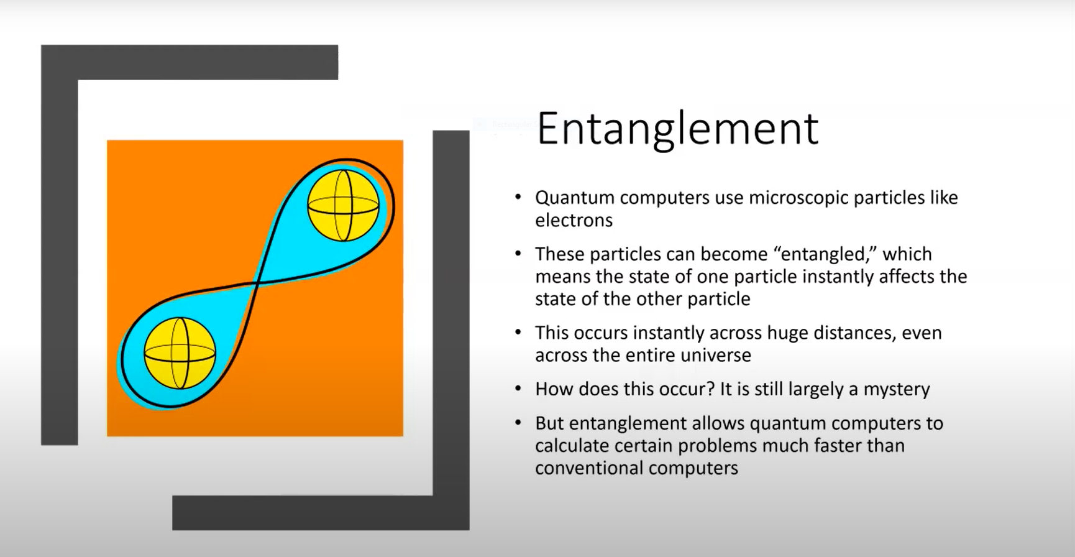

Slide 10
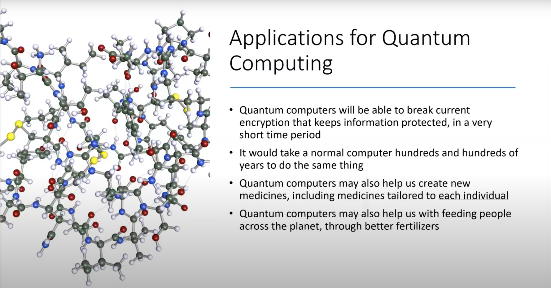

Slide 11
Thank you for giving me this golden opportunity

